Slide 1
Lecture 3.1
Shortest path

Slide 2
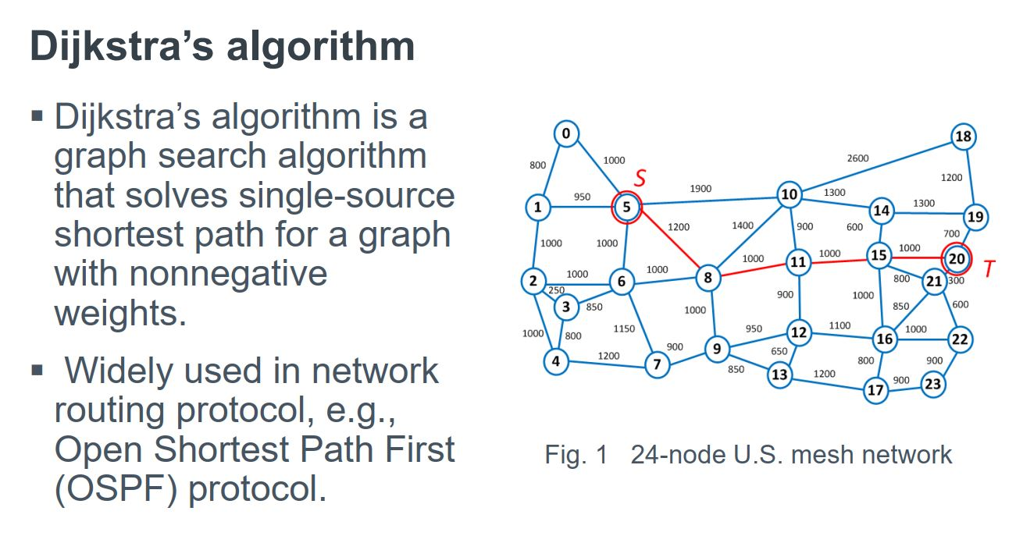
Application

Slide 3
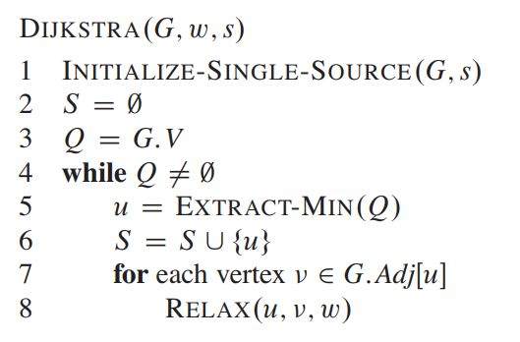
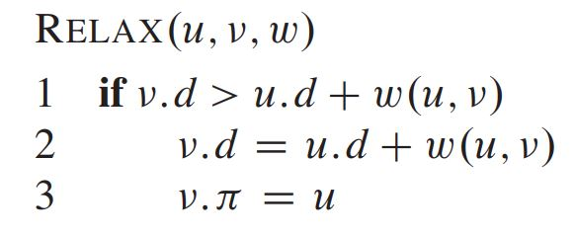
Algorithm

Slide 4
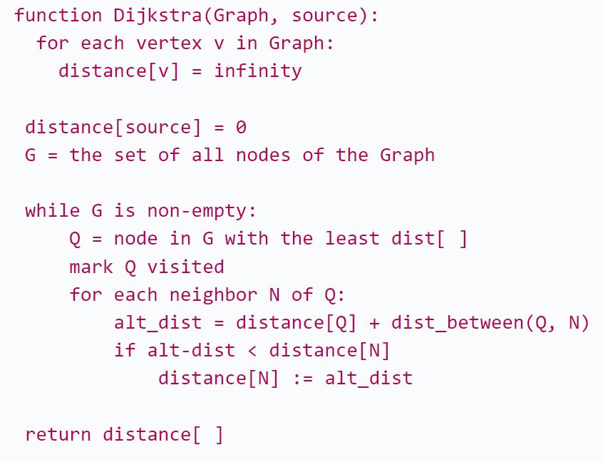
Algorithm

Slide 5
Complexity?

Slide 6
Complexity?
O(V^2)
O(ElogV)
O(V) + O(V*(updating SOME vertices into the queue)) // [Building min heap of n elements take O(n) ]
O(V*logV) + O( (V-1)*logV +…+ 3*logV + 2*logV +1*logV)
//In worst case, there will be v-1 neighbours in first iteration, then (v-2), (v-3)….3.2.1
O(V*logV) + O( (1+2+3+…+V)*logV)
O(V*logV) + O(V^2*logV) // [ sum to n is n(n+1) / 2]
O(V^2*logV)
O(ElogV) // For complete graph [ E = V*(V-1) / 2]

Slide 7
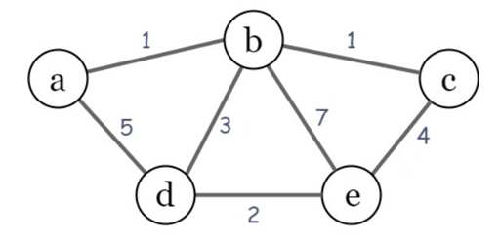
Example

Slide 8
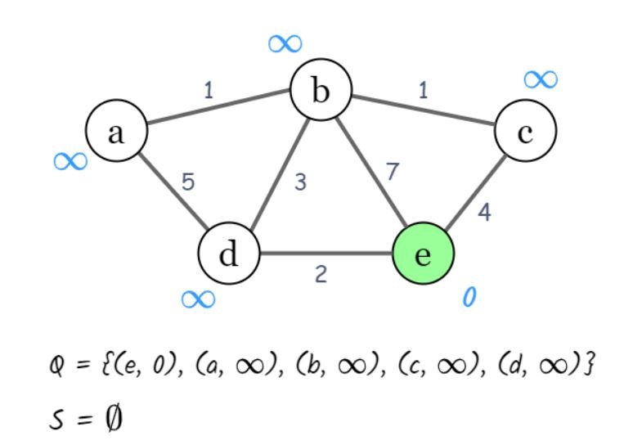
Example

Slide 9
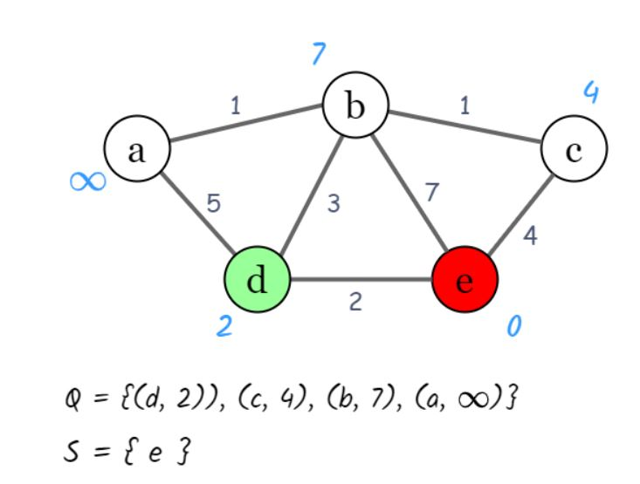
Example

Slide 10
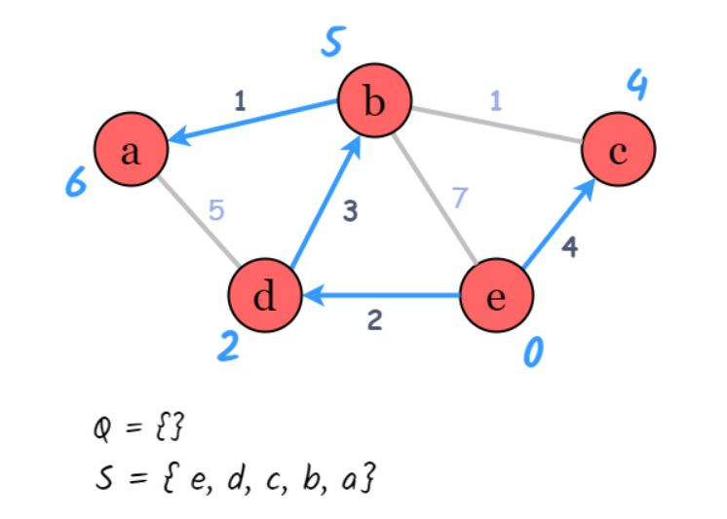
Example

Slide 11
Implementation
vector<pr> adj[MAX]; // For adjacency list

Slide 12
Implementation
typedef pair<int , int> pr;
vector<pr> adj[MAX]; // For adjacency list

Slide 13
Implementation
typedef pair<long long, long long> pr;
vector<pr> adj[MAX]; // For adjacency list
void addEdge(int u, int v, int w){ adj[u].push_back(make_pair(w,v)); adj[v].push_back(make_pair(w,u));
}

Slide 14
Implementation
priority_queue< int > Q; // default sorting is descending
priority_queue<pr, vector<pr>, greater<pr> > Q;

Slide 15
Implementation
for(int i = 1; i <= n; i++){
dist[i] = infinity;
}
dist[src] = 0;
for(int i = 1; i <= n; i++){
Q.push(make_pair(dist[i], i));
}

Slide 16
while(!Q.empty()){
pr node = Q.top();
int cost = node.first;
int label = node.second;
Q.pop();
if(visited[label]) continue;
visited[label] = true;
int sz = adj[label].size();
for(int i = 0; i < sz; i++){
pr nextnode = adj[label].at(i);
int edge_weight = nextnode.first;
int newlabel = nextnode.second;
if(!visited[newlabel]){
int newcost = cost + edge_weight;
if(newcost <= dist[newlabel]){
dist[newlabel] = newcost;
Q.push(make_pair(newcost, newlabel)); }
}
}
}

Slide 17
Problem List:
CSES 1671
https://cses.fi/problemset/task/1671
Codeforces 20C
https://codeforces.com/problemset/problem/20/C/
UVA 112
UVA 10986

